Slide 1
CAUSE OF DEATH ANALYSIS
UDAY RAJ SHARMA

Slide 2
import numpy as np
import pandas as pd
import matplotlib.pyplot as plt
import seaborn as sns
from scipy.stats import kstest
import warnings warnings.filterwarnings('ignore') pd.pandas.set_option('display.max_columns',None)
df=pd.read_csv(r"C:\Users\udayr\cause_of_deaths dataset.csv") df
 | Country/Territory |  | Code | Year | Meningitis | \
0 | Afghanistan |  | AFG | 1990 | 2159
1 | Afghanistan |  | AFG | 1991 | 2218
2 | Afghanistan |  | AFG | 1992 | 2475
3 | Afghanistan |  | AFG | 1993 | 2812
4 ... 6115 | Afghanistan ... Zimbabwe |  | AFG ... ZWE | 1994 ... 2015 | 3027 ... 1439
6116 | Zimbabwe |  | ZWE | 2016 | 1457
6117 | Zimbabwe |  | ZWE | 2017 | 1460
6118 | Zimbabwe |  | ZWE | 2018 | 1450
6119 | Zimbabwe |  | ZWE | 2019 | 1450
 | Alzheimer's | Disease and Other |  |  | Dementias | Parkinson's | Disease | \
0 |  |  |  |  | 1116 |  | 371
1 |  |  |  |  | 1136 |  | 374
2 |  |  |  |  | 1162 |  | 378
3 |  |  |  |  | 1187 |  | 384
4 ... 6115 |  |  |  |  | 1211 ... 754 |  | 391 ... 215
6116 |  |  |  |  | 767 |  | 219
6117 |  |  |  |  | 781 |  | 223
6118 |  |  |  |  | 795 |  | 227
6119 |  |  |  |  | 812 |  | 232
Nutritional Violence \ | Deficiencies | Malaria | Drowning | Interpersonal
0 | 2087 | 93 | 1370
1538
1 | 2153 | 189 | 1391
2001
2 | 2441 | 239 | 1514
2299
3 | 2837 | 108 | 1687
2589
4 | 3081 | 211 | 1809
2849

Slide 3
... ... 6115 | ... 3019 |  | ... 2518 | ... 770
1302
6116 | 3056 |  | 2050 | 801
1342
6117 | 2990 |  | 2116 | 818
1363
6118 | 2918 |  | 2088 | 825
1396
6119 | 2884 |  | 2068 | 827
1434
Maternal Disorders |  | HIV/AIDS | Drug | Use | Disorders
Tuberculosis \
0 | 2655 | 34 | 93 |  |  | 4661
1 | 2885 | 41 | 102 |  |  | 4743
2 | 3315 | 48 | 118 |  |  | 4976
3 | 3671 | 56 | 132 |  |  | 5254
4 | 3863 | 63 | 142 |  |  | 5470
... | ... | ... | ... |  |  | ...
6115 | 1355 | 29162 | 104 |  |  | 11214
6116 | 1338 | 27141 | 110 |  |  | 10998
6117 | 1312 | 24846 | 115 |  |  | 10762
6118 | 1294 | 22106 | 121 |  |  | 10545
6119 | 1294 | 20722 | 127 |  |  | 10465
 | Cardiovascular Diseases | Lower | Respiratory Infections | \
0 | 44899 |  | 23741
1 | 45492 |  | 24504
2 | 46557 |  | 27404
3 | 47951 |  | 31116
4 | 49308 |  | 33390
... | ... |  | ...
6115 | 16649 |  | 12974
6116 | 16937 |  | 13024
6117 | 17187 |  | 12961
6118 | 17460 |  | 12860

Slide 4
6119 | 17810 |  |  |  |  | 12897
 | Neonatal | Disorders |  | Alcohol |  | Use Disorders | Self-harm |  | \
0 |  | 15612 |  |  |  | 72 | 696
1 |  | 17128 |  |  |  | 75 | 751
2 |  | 20060 |  |  |  | 80 | 855
3 |  | 22335 |  |  |  | 85 | 943
4 ... 6115 |  | 23288 ... 9278 |  |  |  | 88 ... 48 | 993 ... 2235
6116 |  | 9065 |  |  |  | 49 | 2296
6117 |  | 8901 |  |  |  | 50 | 2338
6118 |  | 8697 |  |  |  | 51 | 2372
6119 |  | 8609 |  |  |  | 53 | 2403
 | Exposure | to | Forces | of | Nature | Diarrheal Diseases |  | \
0 |  |  |  |  | 0 | 4235
1 |  |  |  |  | 1347 | 4927
2 |  |  |  |  | 614 | 6123
3 |  |  |  |  | 225 | 8174
4 ... 6115 |  |  |  |  | 160 ... 16 | 8215 ... 5102
6116 |  |  |  |  | 31 | 5002
6117 |  |  |  |  | 251 | 4948
6118 |  |  |  |  | 0 | 4745
6119 |  |  |  |  | 660 | 4635
Environmental Heat and Cold Exposure Neoplasms Conflict and Terrorism \
0
1490
1
3370
2
4344
3
4096
4
8959
...
... 6115
13
6116
6
6117
5
6118
9
175
11580
113
11796
38
12218
41
12634
44
12914
...
...
37
11161
37
11465
37
11744
37
12038

Slide 5
6119 |  |  |  | 37 | 12353
11
 | Diabetes Mellitus | Chronic Kidney |  | Disease | Poisonings | \
0 | 2108 |  |  | 3709 | 338
1 | 2120 |  |  | 3724 | 351
2 | 2153 |  |  | 3776 | 386
3 | 2195 |  |  | 3862 | 425
4 ... 6115 | 2231 ... 3176 |  |  | 3932 ... 2108 | 451 ... 381
6116 | 3259 |  |  | 2160 | 393
6117 | 3313 |  |  | 2196 | 398
6118 | 3381 |  |  | 2240 | 400
6119 | 3460 |  |  | 2292 | 405
 | Protein-Energy Malnutrition |  | Road | Injuries | \
0 | 2054 |  |  | 4154
1 | 2119 |  |  | 4472
2 | 2404 |  |  | 5106
3 | 2797 |  |  | 5681
4 ... 6115 | 3038 ... 2990 |  |  | 6001 ... 2373
6116 | 3027 |  |  | 2436
6117 | 2962 |  |  | 2473
6118 | 2890 |  |  | 2509
6119 | 2855 |  |  | 2554
Chronic Respiratory |  | Diseases | \
0 |  | 5945
1 |  | 6050
2 |  | 6223
3 |  | 6445
4 ... 6115 |  | 6664 ... 2751
6116 |  | 2788
6117 |  | 2818
6118 |  | 2849
6119 |  | 2891
Cirrhosis and Other Diseases \ 0 |  | Chronic | Liver | Diseases 2673 | Digestive | 5005
1 |  |  |  | 2728 |  | 5120
2 |  |  |  | 2830 |  | 5335

Slide 6
3 | 2943 |  |  |  |  | 5568
4 | 3027 |  |  |  |  | 5739
... | ... |  |  |  |  | ...
6115 | 1956 |  |  |  |  | 4202
6116 | 1962 |  |  |  |  | 4264
6117 | 2007 |  |  |  |  | 4342
6118 | 2030 |  |  |  |  | 4377
6119 | 2065 |  |  |  |  | 4437
 | Fire, Heat, and Hot | Substances |  | Acute | Hepatitis
0 |  | 323 |  |  | 2985
1 |  | 332 |  |  | 3092
2 |  | 360 |  |  | 3325
3 |  | 396 |  |  | 3601
4 ... 6115 |  | 420 ... 632 |  |  | 3816 ... 146
6116 |  | 648 |  |  | 146
6117 |  | 654 |  |  | 144
6118 |  | 657 |  |  | 139
6119 |  | 662 |  |  | 136
[6120 | rows x 34 columns]
df.head()
Country/Territory Code |  | Year | Meningitis |  | \
0 Afghanistan AFG |  | 1990 | 2159
1 Afghanistan AFG |  | 1991 | 2218
2 Afghanistan AFG |  | 1992 | 2475
3 Afghanistan AFG |  | 1993 | 2812
4 Afghanistan AFG |  | 1994 | 3027
0
1
2
3
4
Alzheimer's Disease and Other Dementias
1116
1136
1162
1187
1211
Parkinson's Disease \
371
374
378
384
391

Slide 7
\ | Nutritional |  | Deficiencies |  |  |  | Malaria |  | Drowning | Interpersonal |  |  | Violence
0 |  |  | 2087 |  |  |  | 93 |  | 1370 |  |  |  | 1538
1 |  |  | 2153 |  |  |  | 189 |  | 1391 |  |  |  | 2001
2 |  |  | 2441 |  |  |  | 239 |  | 1514 |  |  |  | 2299
3 |  |  | 2837 |  |  |  | 108 |  | 1687 |  |  |  | 2589
4 |  |  | 3081 |  |  |  | 211 |  | 1809 |  |  |  | 2849
 | Maternal Disorders |  |  |  | HIV/AIDS |  |  | Drug | Use Disorders |  | Tuberculosis |  |  | \
0 | 2655 |  |  |  | 34 |  |  |  | 93 |  | 4661
1 | 2885 |  |  |  | 41 |  |  |  | 102 |  | 4743
2 | 3315 |  |  |  | 48 |  |  |  | 118 |  | 4976
3 | 3671 |  |  |  | 56 |  |  |  | 132 |  | 5254
4 | 3863 |  |  |  | 63 |  |  |  | 142 |  | 5470
Cardiovascular Disorders \ 0 |  |  |  | Diseases 44899 |  |  | Lower | Respiratory |  | Infections 23741 |  | Neonatal
15612
1 |  |  |  | 45492 |  |  |  |  |  | 24504
17128
2 |  |  |  | 46557 |  |  |  |  |  | 27404
20060
3 |  |  |  | 47951 |  |  |  |  |  | 31116
22335
4 |  |  |  | 49308 |  |  |  |  |  | 33390
23288
 | Alcohol | Use Disorders |  |  |  | Self-harm |  |  | Exposure | to Forces of Nature |  |  |  | \
0 |  | 72 |  |  |  | 696 |  |  |  | 0
1 |  | 75 |  |  |  | 751 |  |  |  | 1347
2 |  | 80 |  |  |  | 855 |  |  |  | 614
3 |  | 85 |  |  |  | 943 |  |  |  | 225
4 |  | 88 |  |  |  | 993 |  |  |  | 160
\ 0
Diarrheal Diseases
Environmental Heat and Cold Exposure
Neoplasms
4235
175
11580
1
4927
113
11796
2
6123
38
12218
3
8174
41
12634

Slide 8
4
8215
44
12914
Conflict Disease \ |  | and | Terrorism | Diabetes |  | Mellitus | Chronic | Kidney
0 |  |  | 1490 |  |  | 2108 |  |  |  | 3709
1 |  |  | 3370 |  |  | 2120 |  |  |  | 3724
2 |  |  | 4344 |  |  | 2153 |  |  |  | 3776
3 |  |  | 4096 |  |  | 2195 |  |  |  | 3862
4 |  |  | 8959 |  |  | 2231 |  |  |  | 3932
 | Poisonings |  | Protein-Energy |  | Malnutrition |  | Road Injuries |  | \
0 | 338 |  |  |  | 2054 |  | 4154
1 | 351 |  |  |  | 2119 |  | 4472
2 | 386 |  |  |  | 2404 |  | 5106
3 | 425 |  |  |  | 2797 |  | 5681
4 | 451 |  |  |  | 3038 |  | 6001
Chronic Respiratory Diseases \ | Diseases | Cirrhosis | and Other Chronic | Liver
0 | 5945
2673
1 | 6050
2728
2 | 6223
2830
3 | 6445
2943
4 | 6664
3027
Digestive Diseases
Fire, Heat, and Hot Substances
Acute Hepatitis
0
5005
323
2985
1
5120
332
3092
2
5335
360
3325
3
5568
396
3601

Slide 9
4
5739
420
3816
pd.set_option('display.max_rows',81)
df.dtypes
Country/Territory | object
Code | object
Year | int64
Meningitis | int64
Alzheimer's Disease and Other Dementias | int64
Parkinson's Disease | int64
Nutritional Deficiencies | int64
Malaria | int64
Drowning | int64
Interpersonal Violence | int64
Maternal Disorders | int64
HIV/AIDS | int64
Drug Use Disorders | int64
Tuberculosis | int64
Cardiovascular Diseases | int64
Lower Respiratory Infections | int64
Neonatal Disorders | int64
Alcohol Use Disorders | int64
Self-harm | int64
Exposure to Forces of Nature | int64
Diarrheal Diseases | int64
Environmental Heat and Cold Exposure | int64
Neoplasms | int64
Conflict and Terrorism | int64
Diabetes Mellitus | int64
Chronic Kidney Disease | int64
Poisonings | int64
Protein-Energy Malnutrition | int64
Road Injuries | int64
Chronic Respiratory Diseases | int64
Cirrhosis and Other Chronic Liver Diseases | int64
Digestive Diseases | int64
Fire, Heat, and Hot Substances | int64
Acute Hepatitis | int64
dtype: object
df['Year']=df.Year.astype('object')
df.info()
<class 'pandas.core.frame.DataFrame'> RangeIndex: 6120 entries, 0 to 6119 Data columns (total 34 columns):
# Column
Non-Null Count
Dtype

Slide 10
0 Country/Territory
6120 non-null
object
1 Code
6120 non-null
object
2 Year
6120 non-null
object
3 | Meningitis |  |  |  | 6120 | non-null | int64
4 | Alzheimer's | Disease | and Other | Dementias | 6120 | non-null | int64
5 | Parkinson's | Disease |  |  | 6120 | non-null | int64
6 Nutritional Deficiencies |  |  |  |  | 6120 | non-null | int64
7 Malaria |  |  |  |  | 6120 | non-null | int64
8 Drowning |  |  |  |  | 6120 | non-null | int64
9 Interpersonal Violence |  |  |  |  | 6120 | non-null | int64
10 Maternal Disorders |  |  |  |  | 6120 | non-null | int64
11 HIV/AIDS |  |  |  |  | 6120 | non-null | int64
12 Drug Use Disorders |  |  |  |  | 6120 | non-null | int64
13 Tuberculosis |  |  |  |  | 6120 | non-null | int64
14 Cardiovascular Diseases |  |  |  |  | 6120 | non-null | int64
15 Lower Respiratory Infections |  |  |  |  | 6120 | non-null | int64
16 Neonatal Disorders |  |  |  |  | 6120 | non-null | int64
17 Alcohol Use Disorders |  |  |  |  | 6120 | non-null | int64
18 Self-harm |  |  |  |  | 6120 | non-null | int64
19 Exposure to Forces of Nature |  |  |  |  | 6120 | non-null | int64
20 Diarrheal Diseases |  |  |  |  | 6120 | non-null | int64
21 Environmental Heat and Cold Exposure |  |  |  |  | 6120 | non-null | int64
22 Neoplasms |  |  |  |  | 6120 | non-null | int64

Slide 11
23 Conflict and Terrorism |  | 6120 | non-null | int64
24 Diabetes Mellitus |  | 6120 | non-null | int64
25 Chronic Kidney Disease |  | 6120 | non-null | int64
26 Poisonings |  | 6120 | non-null | int64
27 Protein-Energy Malnutrition |  | 6120 | non-null | int64
28 Road Injuries |  | 6120 | non-null | int64
29 Chronic Respiratory Diseases |  | 6120 | non-null | int64
30 Cirrhosis and Other Chronic Liver | Diseases | 6120 | non-null | int64
31 Digestive Diseases |  | 6120 | non-null | int64
32 Fire, Heat, and Hot Substances |  | 6120 | non-null | int64
33 Acute Hepatitis |  | 6120 | non-null | int64
dtypes: int64(31), object(3) memory usage: 1.6+ MB
df.isnull().sum()
Country/Territory | 0
Code | 0
Year | 0
Meningitis | 0
Alzheimer's Disease and Other Dementias | 0
Parkinson's Disease | 0
Nutritional Deficiencies | 0
Malaria | 0
Drowning | 0
Interpersonal Violence | 0
Maternal Disorders | 0
HIV/AIDS | 0
Drug Use Disorders | 0
Tuberculosis | 0
Cardiovascular Diseases | 0
Lower Respiratory Infections | 0
Neonatal Disorders | 0
Alcohol Use Disorders | 0
Self-harm | 0
Exposure to Forces of Nature | 0
Diarrheal Diseases | 0

Slide 12
Environmental Heat and Cold Exposure Neoplasms
Conflict and Terrorism Diabetes Mellitus Chronic Kidney Disease Poisonings
Protein-Energy Malnutrition Road Injuries
Chronic Respiratory Diseases
Cirrhosis and Other Chronic Liver Diseases Digestive Diseases
Fire, Heat, and Hot Substances Acute Hepatitis
dtype: int64
# Check Duplicated records
df.duplicated().sum()
0
0
0
0
0
0
0
0
0
0
0
0
0
0
# split data to continous and categorical varaiables. df1_cont=df.select_dtypes(include=['float64','int64']) df1_cat=df.select_dtypes(include=['object'])
# Create Data audit Report for continuous variables
def continuous_var_summary(x):
return pd.Series([x.count(), x.isnull().sum(), x.sum(), x.mean(), x.median(),
x.std(), x.var(), x.min(),x.quantile(0.25),x.quantile(0.50),x.quantile(0.75),x.max()],
index = ['N', 'NMISS', 'SUM', 'MEAN','MEDIAN',
'STD', 'VAR', 'MIN','P25' ,'P50' ,'P75','MAX'])
# Descriptive analysis for continous data
df1_cont.apply(continuous_var_summary)
 | Meningitis | Alzheimer's Disease and Other Dementias \
N | 6.120000e+03 | 6.120000e+03
NMISS | 0.000000e+00 | 0.000000e+00
SUM | 1.052457e+07 | 2.976884e+07
MEAN | 1.719701e+03 | 4.864189e+03
MEDIAN | 1.090000e+02 | 6.665000e+02
STD | 6.672007e+03 | 1.822066e+04
VAR | 4.451568e+07 | 3.319924e+08
MIN | 0.000000e+00 | 0.000000e+00
P25 | 1.500000e+01 | 9.000000e+01
P50 | 1.090000e+02 | 6.665000e+02
P75 | 8.472500e+02 | 2.456250e+03
MAX | 9.835800e+04 | 3.207150e+05
Parkinson's Disease
Nutritional Deficiencies
Malaria \

Slide 13
N | 6.120000e+03 |  | 6.120000e+03 |  |  | 6.120000e+03
NMISS | 0.000000e+00 |  | 0.000000e+00 |  |  | 0.000000e+00
SUM | 7.179795e+06 |  | 1.379203e+07 |  |  | 2.534268e+07
MEAN | 1.173169e+03 |  | 2.253600e+03 |  |  | 4.140960e+03
MEDIAN | 1.640000e+02 |  | 1.190000e+02 |  |  | 0.000000e+00
STD | 4.616156e+03 |  | 1.048363e+04 |  |  | 1.842775e+04
VAR | 2.130890e+07 |  | 1.099066e+08 |  |  | 3.395821e+08
MIN | 0.000000e+00 |  | 0.000000e+00 |  |  | 0.000000e+00
P25 | 2.700000e+01 |  | 9.000000e+00 |  |  | 0.000000e+00
P50 | 1.640000e+02 |  | 1.190000e+02 |  |  | 0.000000e+00
P75 | 6.092500e+02 |  | 1.167250e+03 |  |  | 3.930000e+02
MAX | 7.699000e+04 |  | 2.682230e+05 |  |  | 2.806040e+05
Drowning Interpersonal Violence Maternal Disorders \
N | 6.120000e+03 |  | 6.120000e+03 |  | 6.120000e+03
NMISS | 0.000000e+00 |  | 0.000000e+00 |  | 0.000000e+00
SUM | 1.030200e+07 |  | 1.275284e+07 |  | 7.727046e+06
MEAN | 1.683333e+03 |  | 2.083797e+03 |  | 1.262589e+03
MEDIAN | 1.770000e+02 |  | 2.650000e+02 |  | 5.400000e+01
STD | 8.877018e+03 |  | 6.917006e+03 |  | 6.057973e+03
VAR | 7.880146e+07 |  | 4.784497e+07 |  | 3.669904e+07
MIN | 0.000000e+00 |  | 0.000000e+00 |  | 0.000000e+00
P25 | 3.400000e+01 |  | 4.000000e+01 |  | 5.000000e+00
P50 | 1.770000e+02 |  | 2.650000e+02 |  | 5.400000e+01
P75 | 6.980000e+02 |  | 8.770000e+02 |  | 7.340000e+02
MAX | 1.537730e+05 |  | 6.964000e+04 |  | 1.079290e+05
 | HIV/AIDS | Drug Use Disorders |  | Tuberculosis \
N | 6.120000e+03 | 6.120000e+03 |  | 6.120000e+03
NMISS | 0.000000e+00 | 0.000000e+00 |  | 0.000000e+00
SUM | 3.636442e+07 | 2.656121e+06 |  | 4.585060e+07
MEAN | 5.941899e+03 | 4.340067e+02 |  | 7.491929e+03
MEDIAN | 1.360000e+02 | 2.000000e+01 |  | 4.170000e+02
STD | 2.101196e+04 | 2.898762e+03 |  | 3.954998e+04
VAR | 4.415026e+08 | 8.402819e+06 |  | 1.564201e+09
MIN | 0.000000e+00 | 0.000000e+00 |  | 0.000000e+00
P25 | 1.100000e+01 | 3.000000e+00 |  | 3.500000e+01
P50 | 1.360000e+02 | 2.000000e+01 |  | 4.170000e+02
P75 | 1.879000e+03 | 1.290000e+02 |  | 2.924250e+03
MAX | 3.054910e+05 | 6.571700e+04 |  | 6.575150e+05
 | Cardiovascular Diseases |  | Lower Respiratory Infections \
N | 6.120000e+03 |  | 6.120000e+03
NMISS | 0.000000e+00 |  | 0.000000e+00
SUM | 4.477420e+08 |  | 8.377004e+07
MEAN | 7.316045e+04 |  | 1.368791e+04
MEDIAN | 1.174200e+04 |  | 2.126500e+03
STD | 2.915775e+05 |  | 4.803172e+04
VAR | 8.501746e+10 |  | 2.307046e+09
MIN | 4.000000e+00 |  | 0.000000e+00

Slide 14
P25 | 2.028000e+03 |  |  |  | 3.450000e+02
P50 | 1.174200e+04 |  |  |  | 2.126500e+03
P75 | 4.254650e+04 |  |  |  | 1.016125e+04
MAX | 4.584273e+06 |  |  |  | 6.909130e+05
 | Neonatal Disorders | Alcohol Use Disorders |  |  | Self-harm \
N | 6.120000e+03 | 6.120000e+03 |  |  | 6.120000e+03
NMISS | 0.000000e+00 | 0.000000e+00 |  |  | 0.000000e+00
SUM | 7.686073e+07 | 4.819018e+06 |  |  | 2.371393e+07
MEAN | 1.255894e+04 | 7.874212e+02 |  |  | 3.874825e+03
MEDIAN | 9.160000e+02 | 8.000000e+01 |  |  | 5.330000e+02
STD | 5.605837e+04 | 3.545824e+03 |  |  | 1.842562e+04
VAR | 3.142540e+09 | 1.257287e+07 |  |  | 3.395033e+08
MIN | 0.000000e+00 | 0.000000e+00 |  |  | 0.000000e+00
P25 | 1.310000e+02 | 9.000000e+00 |  |  | 9.400000e+01
P50 | 9.160000e+02 | 8.000000e+01 |  |  | 5.330000e+02
P75 | 7.419750e+03 | 3.160000e+02 |  |  | 1.882250e+03
MAX | 8.527610e+05 | 5.520000e+04 |  |  | 2.203570e+05
Exposure to Forces of Nature Diarrheal Diseases \
N | 6.120000e+03 |  |  | 6.120000e+03
NMISS | 0.000000e+00 |  |  | 0.000000e+00
SUM | 1.490132e+06 |  |  | 6.623551e+07
MEAN | 2.434856e+02 |  |  | 1.082280e+04
MEDIAN | 0.000000e+00 |  |  | 2.965000e+02
STD | 4.717104e+03 |  |  | 6.541617e+04
VAR | 2.225107e+07 |  |  | 4.279276e+09
MIN | 0.000000e+00 |  |  | 0.000000e+00
P25 | 0.000000e+00 |  |  | 2.000000e+01
P50 | 0.000000e+00 |  |  | 2.965000e+02
P75 | 1.200000e+01 |  |  | 3.946750e+03
MAX | 2.226410e+05 |  |  | 1.119477e+06
 | Environmental Heat and |  | Cold Exposure | Neoplasms \
N |  |  | 6.120000e+03 | 6.120000e+03
NMISS |  |  | 0.000000e+00 | 0.000000e+00
SUM |  |  | 1.788851e+06 | 2.297585e+08
MEAN MEDIAN STD VAR MIN P25 P50 P75 MAX |  |  | 2.922959e+02 2.100000e+01 1.704466e+03 2.905206e+06 0.000000e+00 2.000000e+00 2.100000e+01 1.090000e+02 2.904800e+04 | 3.754224e+04 5.629500e+03 1.615584e+05 2.610111e+10 1.000000e+00 8.097500e+02 5.629500e+03 2.014775e+04 2.716551e+06
Conflict and Terrorism
Disease \
N 6.120000e+03
Diabetes Mellitus
Chronic Kidney
6.120000e+03

Slide 15
6.120000e+03 NMISS 0.000000e+00 SUM 2.891169e+07 MEAN 4.724133e+03 MEDIAN 8.220000e+02 STD 1.647043e+04 VAR 2.712751e+08 MIN 0.000000e+00 P25 1.457500e+02 P50 8.220000e+02 P75 2.922500e+03 MAX 2.229220e+05 |  | 0.000000e+00 3.294053e+06 5.382440e+02 0.000000e+00 7.033308e+03 4.946742e+07 0.000000e+00 0.000000e+00 0.000000e+00 2.300000e+01 5.035320e+05 |  | 0.000000e+00 3.144887e+07 5.138705e+03 1.087000e+03 1.677308e+04 2.813362e+08 1.000000e+00 2.360000e+02 1.087000e+03 2.954000e+03 2.730890e+05
 | Poisonings |  | Protein-Energy | Malnutrition | Road Injuries \
N | 6.120000e+03 |  |  | 6.120000e+03 | 6.120000e+03
NMISS | 0.000000e+00 |  |  | 0.000000e+00 | 0.000000e+00
SUM | 2.601082e+06 |  |  | 1.203188e+07 | 3.629647e+07
MEAN MEDIAN STD VAR MIN P25 P50 P75 MAX | 4.250134e+02 5.250000e+01 2.022641e+03 4.091075e+06 0.000000e+00 6.000000e+00 5.250000e+01 2.540000e+02 3.088300e+04 |  |  | 1.965994e+03 9.200000e+01 8.255999e+03 6.816152e+07 0.000000e+00 5.000000e+00 9.200000e+01 1.042500e+03 2.022410e+05 | 5.930796e+03 9.665000e+02 2.409778e+04 5.807032e+08 0.000000e+00 1.747500e+02 9.665000e+02 3.435250e+03 3.292370e+05
N | Chronic Respiratory Diseases 6.120000e+03 |  |  | \
NMISS | 0.000000e+00
SUM | 1.046053e+08
MEAN MEDIAN STD VAR MIN P25 P50 P75 | 1.709237e+04 1.689000e+03 1.051572e+05 1.105803e+10 1.000000e+00 2.890000e+02 1.689000e+03 5.249750e+03

Slide 16
MAX | Cirrhosis | and | 1.366039e+06 Other Chronic | Liver Diseases | Digestive Diseases
\ N |  |  |  | 6.120000e+03 | 6.120000e+03
NMISS |  |  |  | 0.000000e+00 | 0.000000e+00
SUM |  |  |  | 3.747932e+07 | 6.563864e+07
MEAN |  |  |  | 6.124072e+03 | 1.072527e+04
MEDIAN |  |  |  | 1.210000e+03 | 2.185000e+03
STD |  |  |  | 2.068812e+04 | 3.722805e+04
VAR |  |  |  | 4.279983e+08 | 1.385928e+09
MIN |  |  |  | 0.000000e+00 | 0.000000e+00
P25 |  |  |  | 1.540000e+02 | 2.840000e+02
P50 |  |  |  | 1.210000e+03 | 2.185000e+03
P75 |  |  |  | 3.547250e+03 | 6.080000e+03
MAX |  |  |  | 2.700370e+05 | 4.649140e+05
Fire, Heat, and Hot Substances
Acute Hepatitis
N | 6.120000e+03 | 6.120000e+03
NMISS | 0.000000e+00 | 0.000000e+00
SUM | 3.602914e+06 | 3.784791e+06
MEAN | 5.887114e+02 | 6.184299e+02
MEDIAN | 1.260000e+02 | 1.500000e+01
STD | 2.128595e+03 | 4.186023e+03
VAR | 4.530917e+06 | 1.752279e+07
MIN | 0.000000e+00 | 0.000000e+00
P25 | 1.700000e+01 | 2.000000e+00
P50 | 1.260000e+02 | 1.500000e+01
P75 | 4.500000e+02 | 1.600000e+02
MAX | 2.587600e+04 | 6.430500e+04
df1_cat.describe(include=['O'])
 | Country/Territory | Code | Year
count | 6120 | 6120 | 6120
unique | 204 | 204 | 30

Slide 17
top | Afghanistan | AFG 1990
freq | 30 | 30 204
df["Parkinson's Disease"].max()
76990
df["Parkinson's Disease"].unique().min() 0
df['Malaria'].unique().max() 280604
df['Country/Territory'].unique()
array(['Afghanistan', 'Albania', 'Algeria', 'American Samoa', 'Andorra',
'Angola', 'Antigua and Barbuda', 'Argentina', 'Armenia', 'Australia', 'Austria', 'Azerbaijan', 'Bahamas', 'Bahrain', 'Bangladesh', 'Barbados', 'Belarus', 'Belgium', 'Belize',
'Benin',
'Bermuda', 'Bhutan', 'Bolivia', 'Bosnia and Herzegovina', 'Botswana', 'Brazil', 'Brunei', 'Bulgaria', 'Burkina Faso', 'Burundi', 'Cambodia', 'Cameroon', 'Canada', 'Cape Verde', 'Central African Republic', 'Chad', 'Chile', 'China',
'Colombia',
'Comoros', 'Congo', 'Cook Islands', 'Costa Rica', "Cote d'Ivoire",
'Croatia', 'Cuba', 'Cyprus', 'Czechia',
'Democratic Republic of Congo', 'Denmark', 'Djibouti', 'Dominica',
'Dominican Republic', 'Ecuador', 'Egypt', 'El Salvador', 'Equatorial Guinea', 'Eritrea', 'Estonia', 'Eswatini',
'Ethiopia',
'Fiji', 'Finland', 'France', 'Gabon', 'Gambia', 'Georgia',
'Germany', 'Ghana', 'Greece', 'Greenland', 'Grenada', 'Guam', 'Guatemala', 'Guinea', 'Guinea-Bissau', 'Guyana', 'Haiti', 'Honduras', 'Hungary', 'Iceland', 'India', 'Indonesia', 'Iran',
'Iraq', 'Ireland', 'Israel', 'Italy', 'Jamaica', 'Japan', 'Jordan',
'Kazakhstan', 'Kenya', 'Kiribati', 'Kuwait', 'Kyrgyzstan',
'Laos',
'Latvia', 'Lebanon', 'Lesotho', 'Liberia', 'Libya', 'Lithuania',
'Luxembourg', 'Madagascar', 'Malawi', 'Malaysia', 'Maldives', 'Mali', 'Malta', 'Marshall Islands', 'Mauritania', 'Mauritius', 'Mexico', 'Micronesia', 'Moldova', 'Monaco', 'Mongolia', 'Montenegro', 'Morocco', 'Mozambique', 'Myanmar', 'Namibia', 'Nauru', 'Nepal', 'Netherlands', 'New Zealand', 'Nicaragua', 'Niger', 'Nigeria', 'Niue', 'North Korea', 'North Macedonia',

Slide 18
'Northern Mariana Islands', 'Norway', 'Oman', 'Pakistan', 'Palau',
'Palestine', 'Panama', 'Papua New Guinea', 'Paraguay', 'Peru', 'Philippines', 'Poland', 'Portugal', 'Puerto Rico', 'Qatar', 'Romania', 'Russia', 'Rwanda', 'Saint Kitts and Nevis',
'Saint Lucia', 'Saint Vincent and the Grenadines', 'Samoa', 'San Marino', 'Sao Tome and Principe', 'Saudi Arabia',
'Senegal',
'Serbia', 'Seychelles', 'Sierra Leone', 'Singapore', 'Slovakia',
'Slovenia', 'Solomon Islands', 'Somalia', 'South Africa', 'South Korea', 'South Sudan', 'Spain', 'Sri Lanka', 'Sudan', 'Suriname', 'Sweden', 'Switzerland', 'Syria', 'Taiwan', 'Tajikistan', 'Tanzania', 'Thailand', 'Timor', 'Togo',
'Tokelau',
'Tonga', 'Trinidad and Tobago', 'Tunisia', 'Turkey', 'Turkmenistan', 'Tuvalu', 'Uganda', 'Ukraine',
'United Arab Emirates', 'United Kingdom', 'United States', 'United States Virgin Islands', 'Uruguay', 'Uzbekistan',
'Vanuatu',
'Venezuela', 'Vietnam', 'Yemen', 'Zambia', 'Zimbabwe'], dtype=object)
df['Country/Territory'].value_counts()
Afghanistan | 30
Papua New Guinea | 30
Niue | 30
North Korea | 30
North Macedonia | 30
 | ..
Greenland | 30
Grenada | 30
Guam | 30
Guatemala | 30
Zimbabwe | 30
Name: Country/Territory, Length: 204, dtype: int64
len(df['Country/Territory'].unique()) 204
# Check Normality of continous data
for i in df1_cont.columns: sns.distplot(df1_cont[i]) print(kstest(df1_cont[i].values,'norm')) plt.show()
KstestResult(statistic=0.8829688223001868, pvalue=0.0)

Slide 19
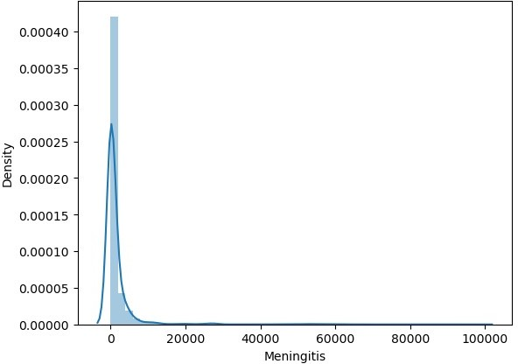
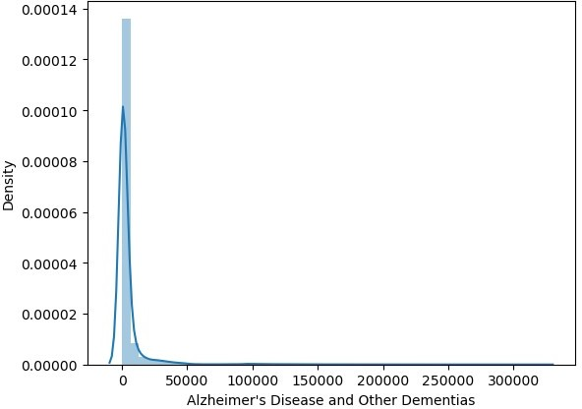
KstestResult(statistic=0.9661337620990889, pvalue=0.0)

Slide 20
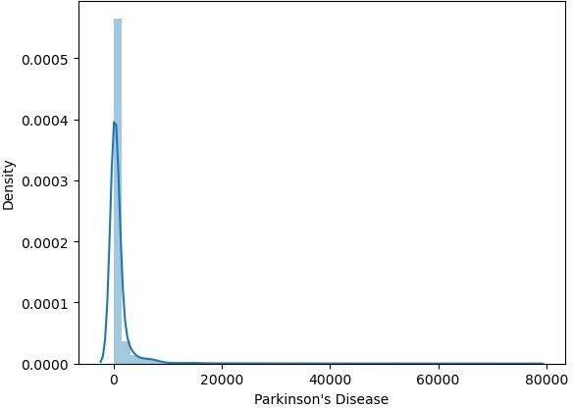
KstestResult(statistic=0.9471795137330757, pvalue=0.0)
KstestResult(statistic=0.8811714366792718, pvalue=0.0)

Slide 21
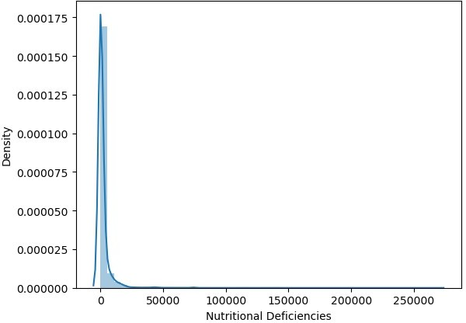
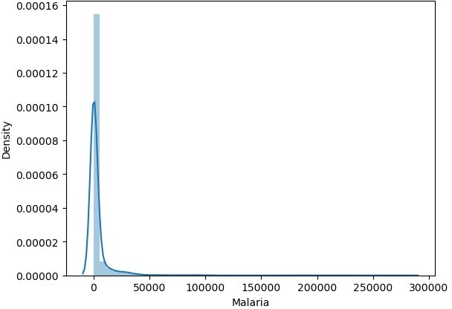
KstestResult(statistic=0.5, pvalue=0.0)
KstestResult(statistic=0.9483233045827489, pvalue=0.0)

Slide 22
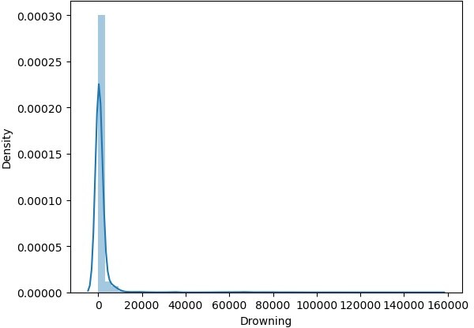
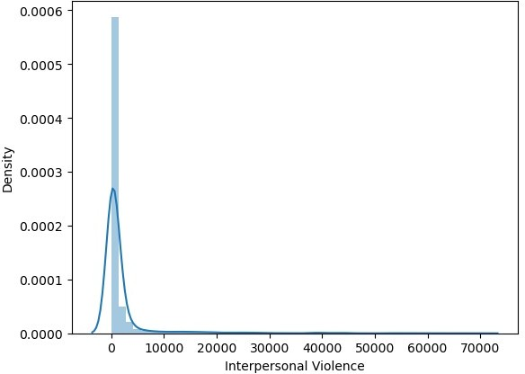
KstestResult(statistic=0.9432579451056248, pvalue=0.0)

Slide 23
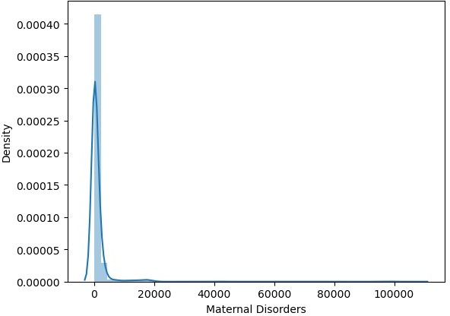
KstestResult(statistic=0.8373805870060691, pvalue=0.0)
KstestResult(statistic=0.8888511752413633, pvalue=0.0)

Slide 24
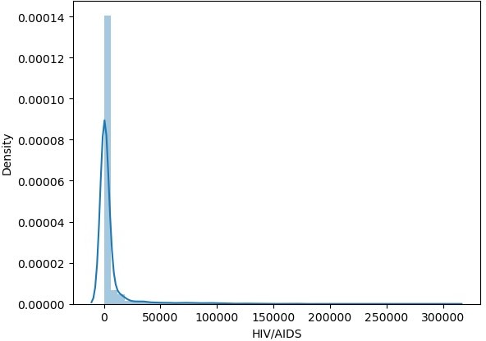
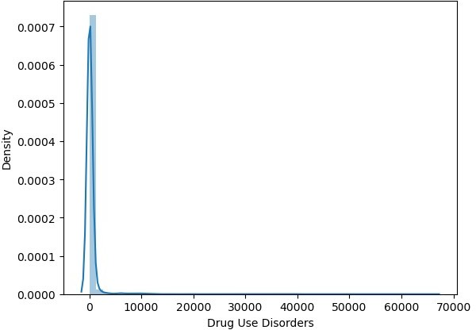
KstestResult(statistic=0.7891779726269842, pvalue=0.0)

Slide 25
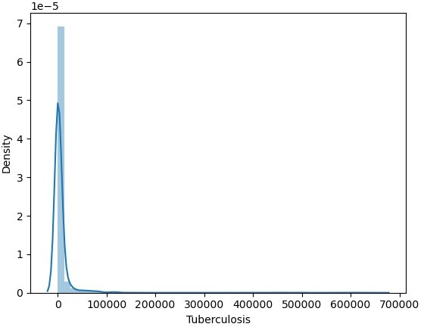
KstestResult(statistic=0.9063298405304614, pvalue=0.0)
KstestResult(statistic=0.9999683287581669, pvalue=0.0)

Slide 26
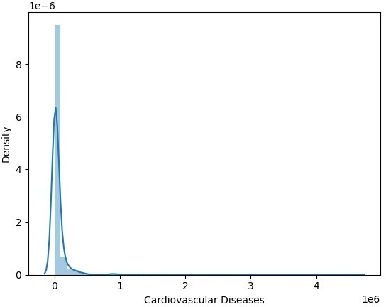
KstestResult(statistic=0.9901644071895395, pvalue=0.0)

Slide 27
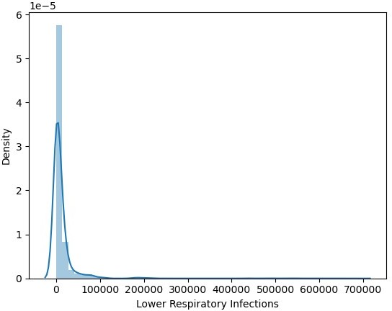
KstestResult(statistic=0.9586174222298078, pvalue=0.0)

Slide 28
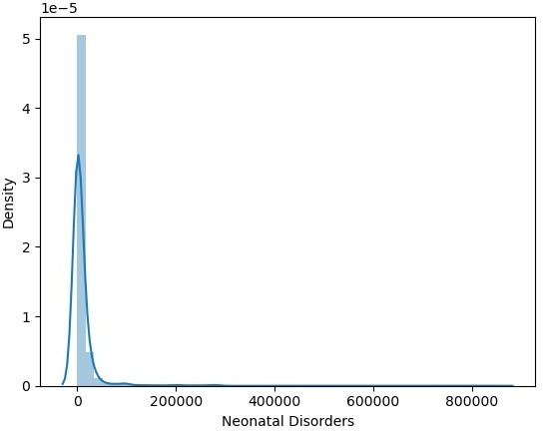
KstestResult(statistic=0.8803544432152195, pvalue=0.0)

Slide 29
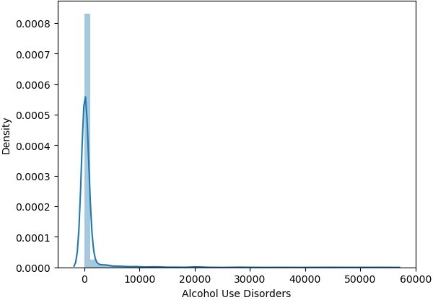
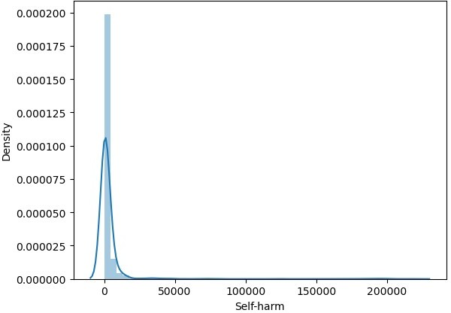
KstestResult(statistic=0.967604350334383, pvalue=0.0)
KstestResult(statistic=0.5, pvalue=0.0)

Slide 30
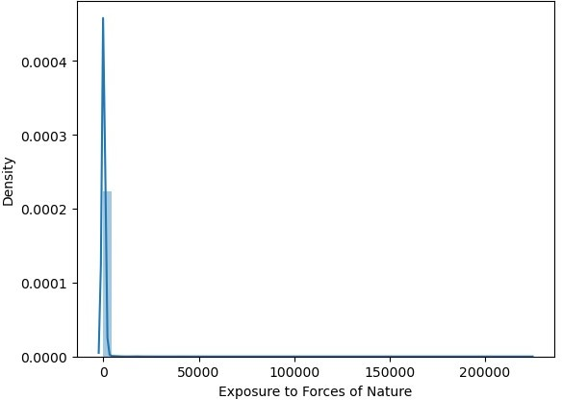
KstestResult(statistic=0.9086224170714287, pvalue=0.0)

Slide 31
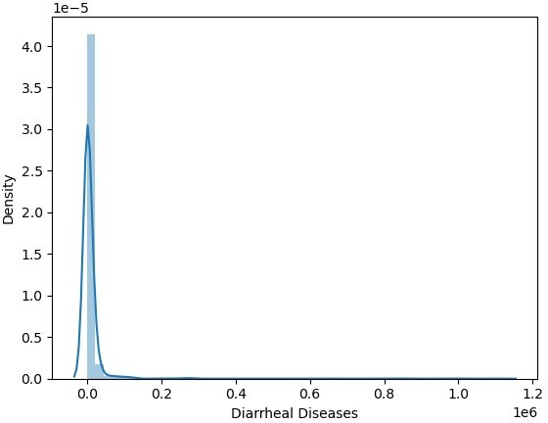
KstestResult(statistic=0.7628707830845005, pvalue=0.0)

Slide 32
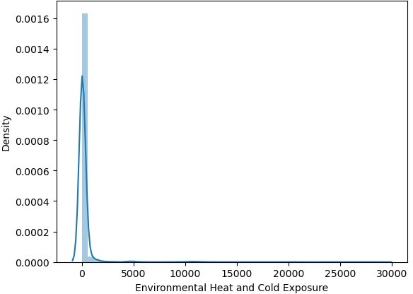
KstestResult(statistic=0.9937481411840562, pvalue=0.0)

Slide 33
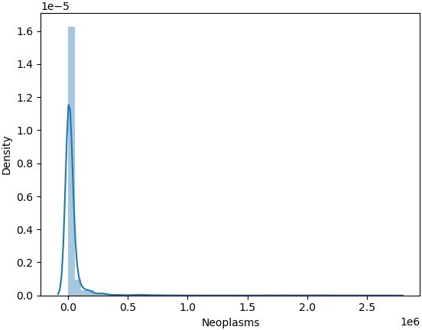
KstestResult(statistic=0.5, pvalue=0.0)

Slide 34
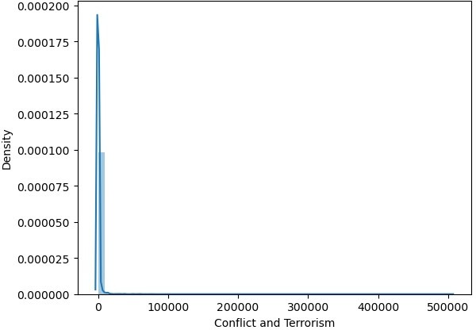
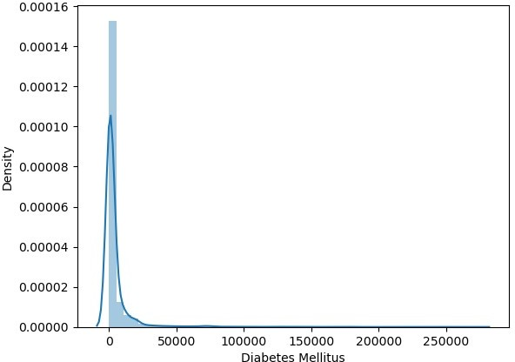
KstestResult(statistic=0.9919507555631412, pvalue=0.0)

Slide 35
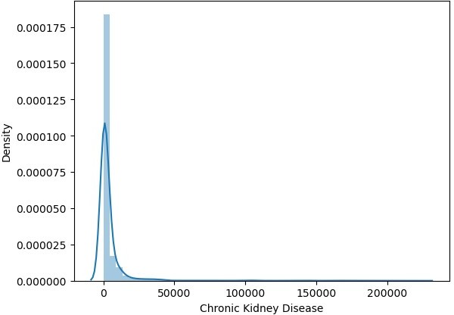
KstestResult(statistic=0.9849246117722915, pvalue=0.0)
KstestResult(statistic=0.8133609791629319, pvalue=0.0)

Slide 36
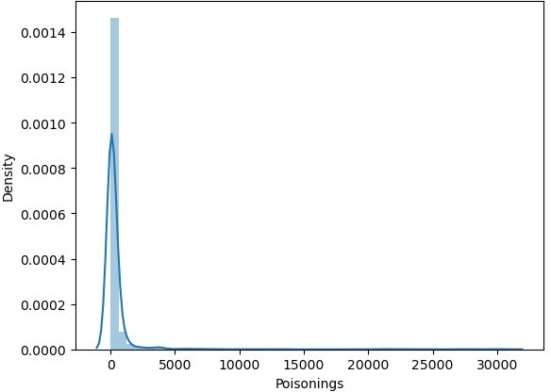
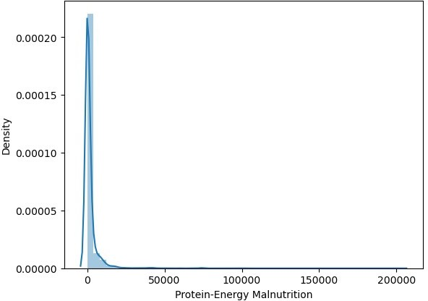
KstestResult(statistic=0.8520864693590103, pvalue=0.0)

Slide 37

KstestResult(statistic=0.9829638274585659, pvalue=0.0)
KstestResult(statistic=0.9890206163398663, pvalue=0.0)

Slide 38
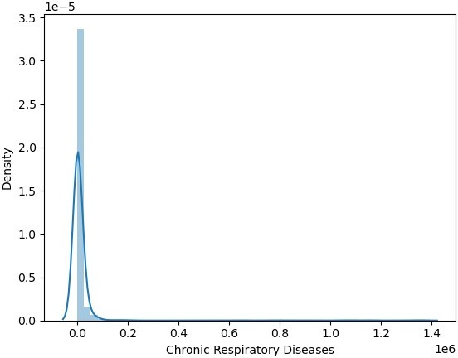
KstestResult(statistic=0.9738135006611803, pvalue=0.0)

Slide 39
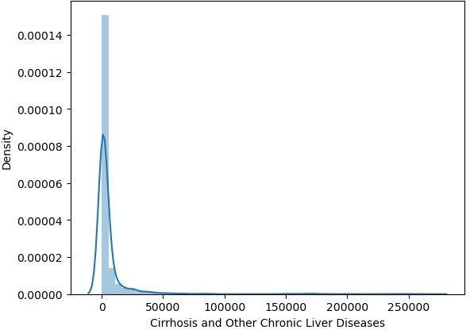
KstestResult(statistic=0.9878657882428797, pvalue=0.0)

Slide 40
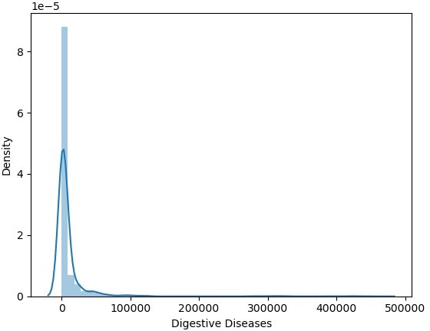
KstestResult(statistic=0.895550521646592, pvalue=0.0)

Slide 41
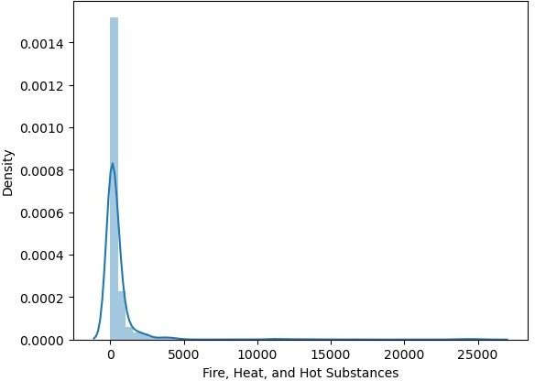
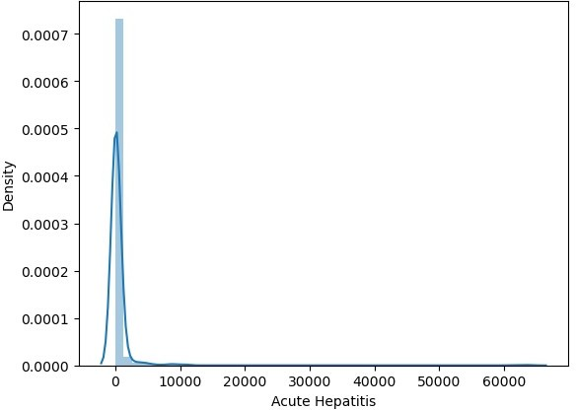
KstestResult(statistic=0.75551784190803, pvalue=0.0)

Slide 42
df1_cont.skew()
Meningitis | 8.248599
Alzheimer's Disease and Other Dementias | 8.695288
Parkinson's Disease | 9.321242
Nutritional Deficiencies | 14.863496
Malaria | 9.159105
Drowning | 10.553901
Interpersonal Violence | 5.777146
Maternal Disorders | 12.278358
HIV/AIDS | 6.610169
Drug Use Disorders | 13.367100
Tuberculosis | 12.022406
Cardiovascular Diseases | 9.411914
Lower Respiratory Infections | 9.036604
Neonatal Disorders | 10.447536
Alcohol Use Disorders | 9.253511
Self-harm | 8.973653
Exposure to Forces of Nature | 34.507640
Diarrheal Diseases | 12.563758
Environmental Heat and Cold Exposure | 10.631493
Neoplasms | 10.748333
Conflict and Terrorism | 60.707004
Diabetes Mellitus | 8.022653
Chronic Kidney Disease | 7.919364
Poisonings | 10.929760
Protein-Energy Malnutrition | 13.115196
Road Injuries | 9.466209
Chronic Respiratory Diseases | 10.298131
Cirrhosis and Other Chronic Liver Diseases | 7.764715
Digestive Diseases | 8.026536
Fire, Heat, and Hot Substances | 8.578848
Acute Hepatitis dtype: float64 | 12.756098
df2=df.copy()
# The unique Year data in the Dataframe
df1_cat['Year'].unique()
array([1990, | 1991, | 1992, | 1993, | 1994, | 1995, | 1996, | 1997, 1998, 1999,
2000,
2001, | 2002, | 2003, | 2004, | 2005, | 2006, | 2007, | 2008, 2009, 2010,
2011,
2012, 2013, 2014, 2015, 2016, 2017, 2018, 2019], dtype=object)
# Creating a new column for 'Total_no_of_Deaths' for individual Country and Year
df2['Total_no_of_Deaths'] = df2.sum(axis=1)

Slide 43
df2 | Country/Territory Code Year | Meningitis | \
0 | Afghanistan AFG 1990 | 2159
1 | Afghanistan AFG 1991 | 2218
2 | Afghanistan AFG 1992 | 2475
3 | Afghanistan AFG 1993 | 2812
4 ... 6115 | Afghanistan AFG 1994 ... ... ... Zimbabwe ZWE 2015 | 3027 ... 1439
6116 | Zimbabwe ZWE 2016 | 1457
6117 | Zimbabwe ZWE 2017 | 1460
6118 | Zimbabwe ZWE 2018 | 1450
6119 | Zimbabwe ZWE 2019 | 1450
 | Alzheimer's Disease and Other | Dementias | Parkinson's Disease | \
0 |  | 1116 | 371
1 |  | 1136 | 374
2 |  | 1162 | 378
3 |  | 1187 | 384
4 ... 6115 |  | 1211 ... 754 | 391 ... 215
6116 |  | 767 | 219
6117 |  | 781 | 223
6118 |  | 795 | 227
6119 |  | 812 | 232
Nutritional Violence \ | Deficiencies | Malaria | Drowning | Interpersonal
0 | 2087 | 93 | 1370
1538
1 | 2153 | 189 | 1391
2001
2 | 2441 | 239 | 1514
2299
3 | 2837 | 108 | 1687
2589
4 | 3081 | 211 | 1809
2849
... | ... | ... | ...
...
6115 | 3019 | 2518 | 770
1302
6116 | 3056 | 2050 | 801
1342
6117 | 2990 | 2116 | 818
1363
6118 | 2918 | 2088 | 825
1396

Slide 44
6119
1434
2884
2068
827
Maternal Disorders HIV/AIDS Drug Use Disorders Tuberculosis \
0 | 2655 |  | 34 |  | 93 |  | 4661
1 | 2885 |  | 41 |  | 102 |  | 4743
2 | 3315 |  | 48 |  | 118 |  | 4976
3 | 3671 |  | 56 |  | 132 |  | 5254
4 | 3863 |  | 63 |  | 142 |  | 5470
... | ... |  | ... |  | ... |  | ...
6115 | 1355 |  | 29162 |  | 104 |  | 11214
6116 | 1338 |  | 27141 |  | 110 |  | 10998
6117 | 1312 |  | 24846 |  | 115 |  | 10762
6118 | 1294 |  | 22106 |  | 121 |  | 10545
6119 | 1294 |  | 20722 |  | 127 |  | 10465
 | Cardiovascular Diseases |  | Lower |  | Respiratory | Infections | \
0 | 44899 |  |  |  |  | 23741
1 | 45492 |  |  |  |  | 24504
2 | 46557 |  |  |  |  | 27404
3 | 47951 |  |  |  |  | 31116
4 ... 6115 | 49308 ... 16649 |  |  |  |  | 33390 ... 12974
6116 | 16937 |  |  |  |  | 13024
6117 | 17187 |  |  |  |  | 12961
6118 | 17460 |  |  |  |  | 12860
6119 | 17810 |  |  |  |  | 12897
 | Neonatal Disorders | Alcohol |  | Use Disorders |  | Self-harm | \
0 | 15612 |  |  | 72 |  | 696
1 | 17128 |  |  | 75 |  | 751
2 | 20060 |  |  | 80 |  | 855
3 | 22335 |  |  | 85 |  | 943
4 ... 6115 | 23288 ... 9278 |  |  | 88 ... 48 |  | 993 ... 2235

Slide 45
6116 | 9065 |  |  |  | 49 |  |  |  | 2296
6117 | 8901 |  |  |  | 50 |  |  |  | 2338
6118 | 8697 |  |  |  | 51 |  |  |  | 2372
6119 | 8609 |  |  |  | 53 |  |  |  | 2403
 | Exposure | to | Forces |  | of | Nature | Diarrheal Diseases |  | \
0 |  |  |  |  |  | 0 | 4235
1 |  |  |  |  |  | 1347 | 4927
2 |  |  |  |  |  | 614 | 6123
3 |  |  |  |  |  | 225 | 8174
4 ... 6115 |  |  |  |  |  | 160 ... 16 | 8215 ... 5102
6116 |  |  |  |  |  | 31 | 5002
6117 |  |  |  |  |  | 251 | 4948
6118 |  |  |  |  |  | 0 | 4745
6119 |  |  |  |  |  | 660 | 4635
Environmental Terrorism \ 0 |  |  |  | Heat | and | Cold | Exposure 175 | Neoplasms 11580 | Conflict | and
1490
1 |  |  |  |  |  |  | 113 | 11796
3370
2 |  |  |  |  |  |  | 38 | 12218
4344
3 |  |  |  |  |  |  | 41 | 12634
4096
4 |  |  |  |  |  |  | 44 | 12914
8959 ... ... 6115 |  |  |  |  |  |  | ... 37 | ... 11161
13
6116 |  |  |  |  |  |  | 37 | 11465
6
6117 |  |  |  |  |  |  | 37 | 11744
5
6118 |  |  |  |  |  |  | 37 | 12038
9
6119 |  |  |  |  |  |  | 37 | 12353
11
 | Diabetes Mellitus | Chronic Kidney Disease | Poisonings | \
0 | 2108 | 3709 | 338
1 | 2120 | 3724 | 351
2 | 2153 | 3776 | 386
3 | 2195 | 3862 | 425
4 | 2231 | 3932 | 451
... | ... | ... | ...

Slide 46
6115 | 3176 |  | 2108 |  | 381
6116 | 3259 |  | 2160 |  | 393
6117 | 3313 |  | 2196 |  | 398
6118 | 3381 |  | 2240 |  | 400
6119 | 3460 |  | 2292 |  | 405
 | Protein-Energy Malnutrition |  | Road | Injuries | \
0 | 2054 |  |  | 4154
1 | 2119 |  |  | 4472
2 | 2404 |  |  | 5106
3 | 2797 |  |  | 5681
4 ... 6115 | 3038 ... 2990 |  |  | 6001 ... 2373
6116 | 3027 |  |  | 2436
6117 | 2962 |  |  | 2473
6118 | 2890 |  |  | 2509
6119 | 2855 |  |  | 2554
Chronic Respiratory |  | Diseases | \
0 |  | 5945
1 |  | 6050
2 |  | 6223
3 |  | 6445
4 ... 6115 |  | 6664 ... 2751
6116 |  | 2788
6117 |  | 2818
6118 |  | 2849
6119 |  | 2891
Cirrhosis and Other Diseases \ 0 |  | Chronic | Liver | Diseases 2673 | Digestive | 5005
1 |  |  |  | 2728 |  | 5120
2 |  |  |  | 2830 |  | 5335
3 |  |  |  | 2943 |  | 5568
4 |  |  |  | 3027 |  | 5739
... |  |  |  | ... |  | ...
6115 |  |  |  | 1956 |  | 4202
6116 |  |  |  | 1962 |  | 4264

Slide 47
6117 | 2007 |  |  |  | 4342
6118 | 2030 |  |  |  | 4377
6119 | 2065 |  |  |  | 4437
Fire, Heat, and Total_no_of_Deaths 0 | Hot | Substances 323 | Acute | Hepatitis 2985
147971
1 |  | 332 |  | 3092
156844
2 |  | 360 |  | 3325
169156
3 |  | 396 |  | 3601
182230
4 |  | 420 |  | 3816
194795 ... ... 6115 |  | ... 632 |  | ... 146
130080
6116 |  | 648 |  | 146
128274
6117 |  | 654 |  | 144
126515
6118 |  | 657 |  | 139
123506
6119 |  | 662 |  | 136
123540
[6120 rows x 35 columns]
Bivariate analysis
for i in df1_cont.columns: df2.groupby('Country/Territory')
[i].sum().sort_values(ascending=False).head().plot(kind='bar') plt.title('Top 5 countries having death due to '+i) plt.ylabel('Sum of Deaths')
plt.show()

Slide 48
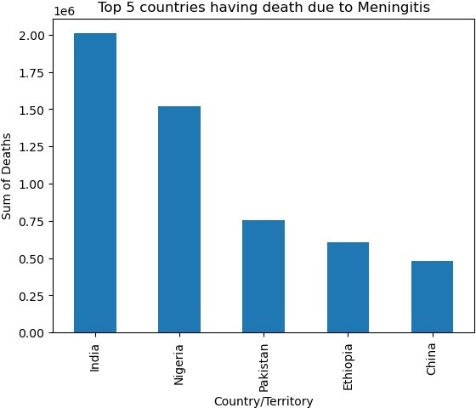

Slide 49
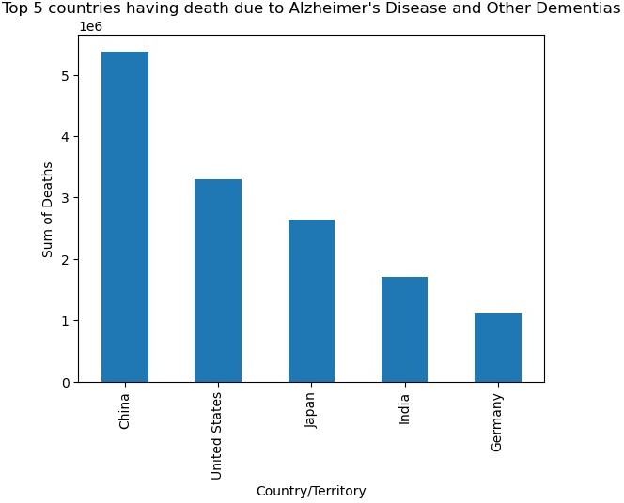

Slide 50
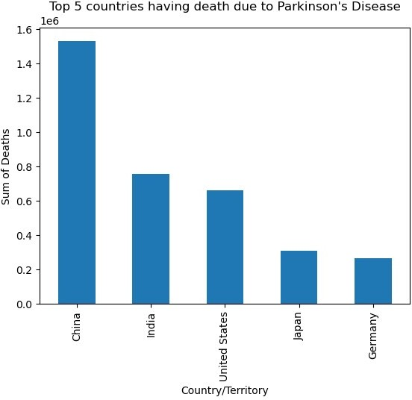

Slide 51
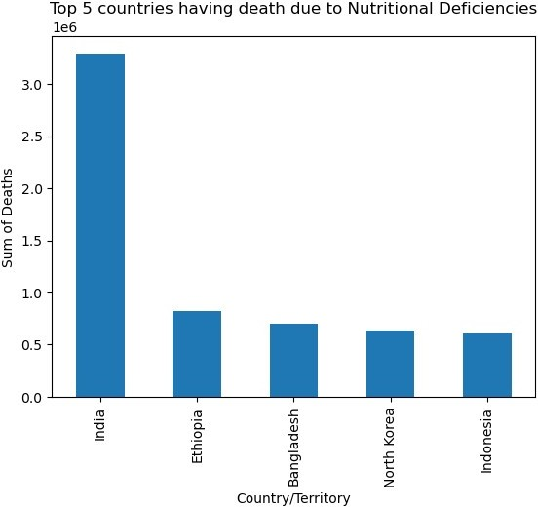

Slide 52
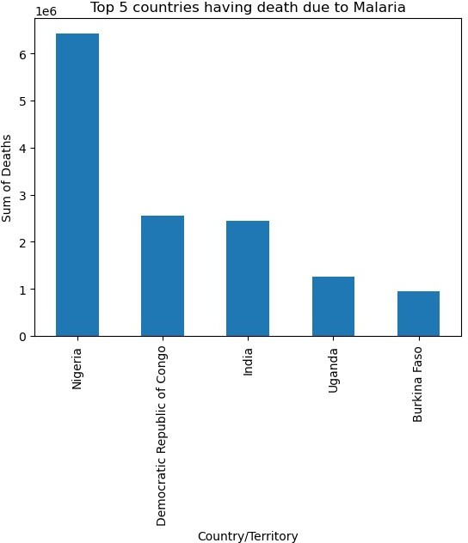

Slide 53
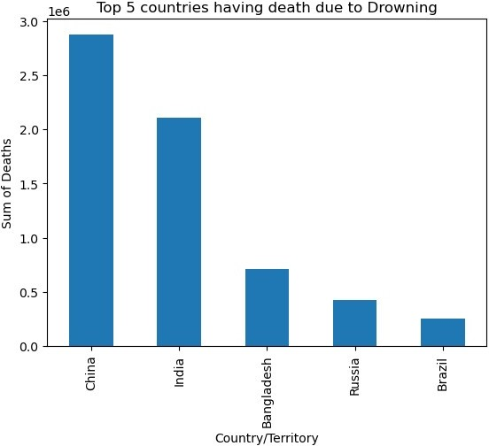

Slide 54
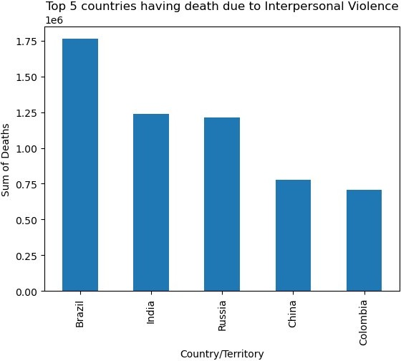

Slide 55
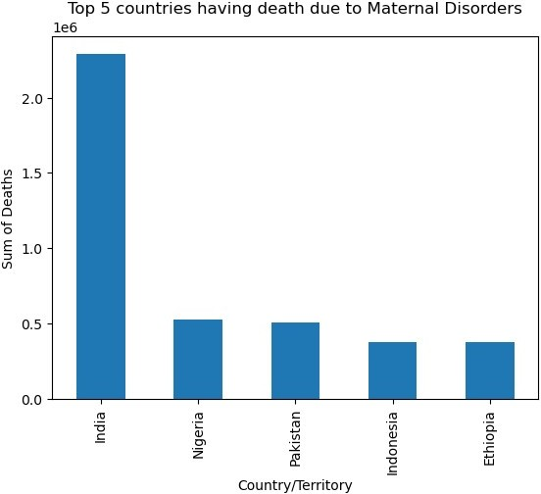

Slide 56
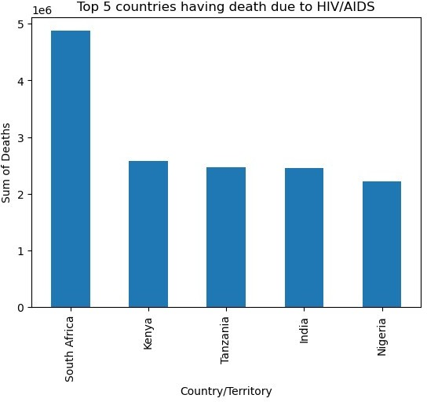

Slide 57
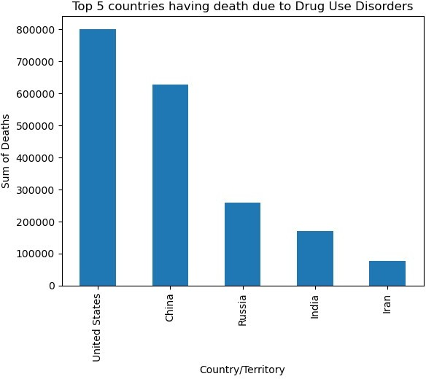

Slide 58
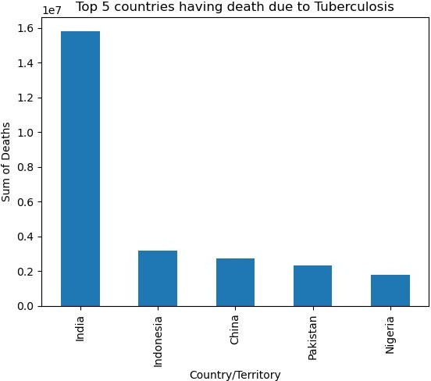

Slide 59
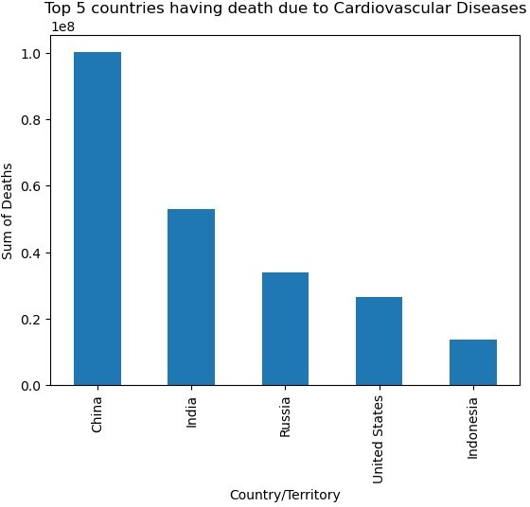

Slide 60
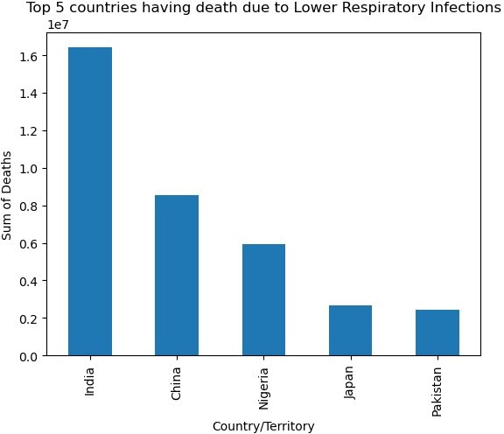

Slide 61
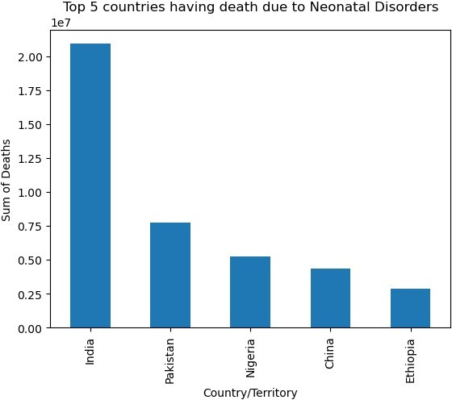

Slide 62
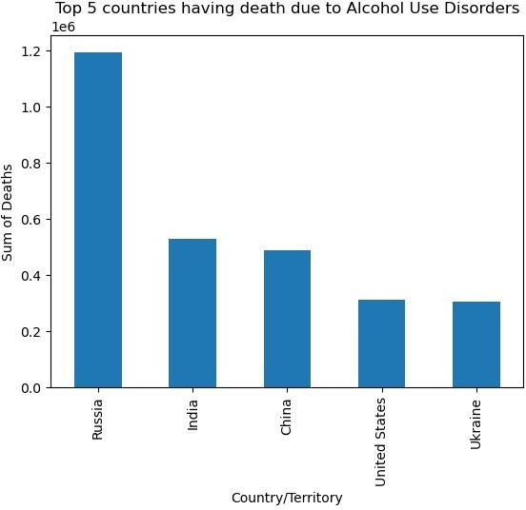

Slide 63
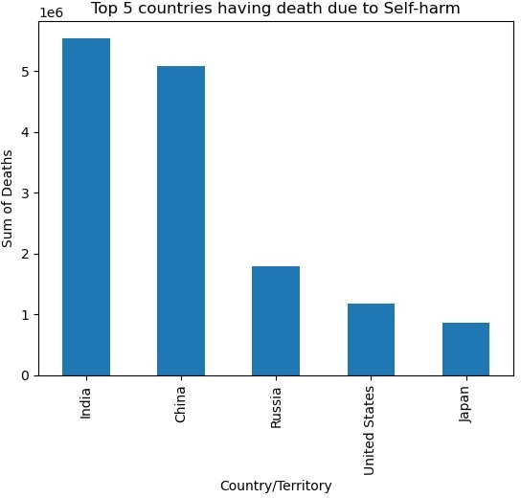

Slide 64
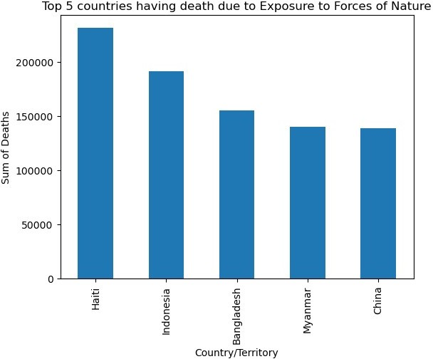

Slide 65
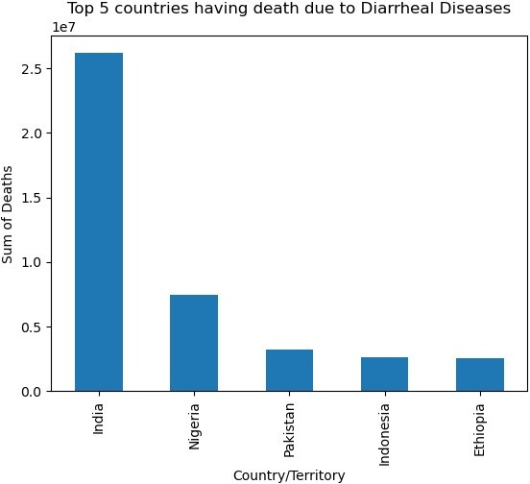

Slide 66
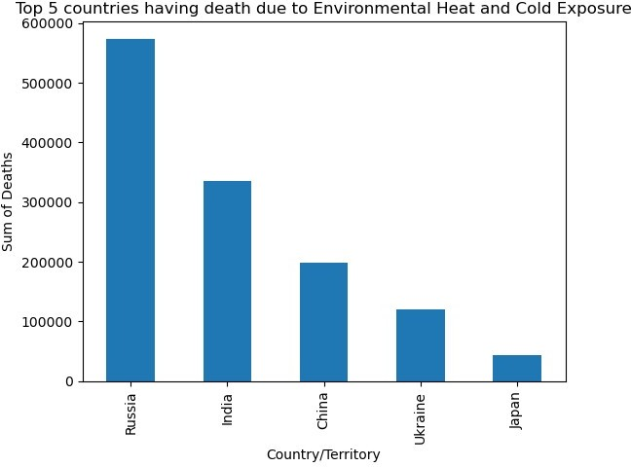

Slide 67
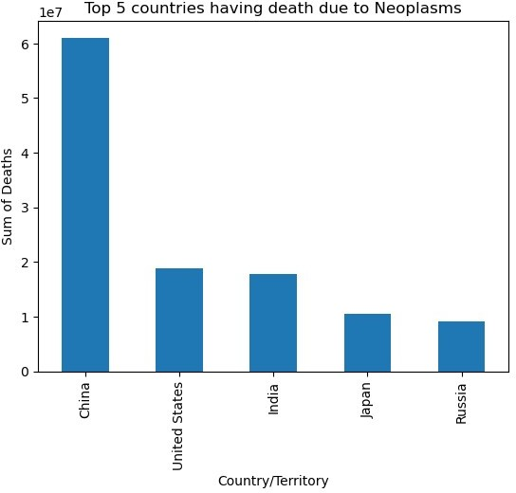

Slide 68


Slide 69


Slide 70


Slide 71


Slide 72


Slide 73


Slide 74


Slide 75


Slide 76


Slide 77


Slide 78

# Top countries in different death disease/enviroment from above graphs
# India---- Meningits, Nutritional Deficiencies, Maternal Disorders,
Tuberculosis, Lower Respiratory Infections, Self-harm
# Neonatal Disorders,Diarrheal Diseases, Diabetes Mellitus,Choronic kidney,Protein-energy malnutrition,Digestive,Acute Hepatitis
# Cirrhosis & other chronic liver, Fire/heat & hot substances
# China---- Alzheimer, Parkinson, Drowning, Cardiovascular Diseases,
Neoplasms, Poisonings, Road injuries, Chronic respiratory # Nigeria---- Malaria
# Brazil---- Interpersonal Violence # South Africa---- HIV/AIDS
# USA---- Drug use Disorders
# Russia---- Alcohol use Disorders, Environmental Heat&cold exposure # Haiti---- Exposure to forces of nature
# Rwanda---- Conflict & Terrorism
df2.groupby('Country/Territory') ['Total_no_of_Deaths'].sum().sort_values(ascending=False).head().plot(

Slide 79

kind='barh') plt.show()
# China - "Total_no_of_Deaths" against "Year"
China_Total_no_of_Deaths = df2[df2['Country/Territory']=='China'].sort_values(by='Total_no_of_Dea ths',ascending=False)
plt.figure(figsize=(8,4),dpi=200) sns.scatterplot(data=China_Total_no_of_Deaths, x='Year', y='Total_no_of_Deaths')
plt.xlabel("Year") plt.ylabel("Total no.of Deaths")
plt.title("Year Vs. Total no.of Deaths for China") plt.show();

Slide 80


